Slide 1
Managed By
Mentored By
Visual Intelligence Team
Dr. Neeraj Gadgil
Siddhartha Watsa
Perceptual Video Pre-Processor
By Priyanshu Sharma

Slide 2
Executive Summary
Project Overview:
Objective: Develop a perceptual preprocessor using AVC (Advanced Video Codec) for image optimization
Platform: Android mobile application
Core Technology: AVC codec for perceptual preprocessing
Challenge: Working around Android's YUV format limitations
Key Achievements:
Successfully implemented 4 processing paths for comprehensive testing
Integrated AVC codec despite platform constraints
Developed format conversion pipeline (YUV420 → YUV422 → NV21/YUY2)
Implemented PSNR metrics for quality assessment

Slide 3



Problem Statement
Why Perceptual Preprocessing?
Image Quality: Standard compression loses perceptually important details
Bandwidth Optimization: Need to reduce file sizes without visible quality loss
Device Constraints: Mobile devices require efficient processing
User Experience: Faster uploads and downloads with maintained visual quality
The Perceptual Advantage: Perceptual preprocessing leverages human visual system characteristics to:
Preserve details in areas where the eye is most sensitive
Optimize compression in less noticeable regions
Achieve better compression ratios with minimal perceived quality loss
Metric Cards:
Traditional Compression: 100% File Size
With Perceptual Preprocessing: 25-30% File Size with Similar Perceived Quality

Slide 4
Technical Challenges
Core Challenge: Android natively supports only YUV420 format for image reading, while AVC algorithm requires YUV422 or YUV444
Format Capability Matrix:
Component | Supported Formats | Challenge
Android ImageReader | YUV420 only | Cannot directly read YUV422/444
AVC algorithm | YUV422, YUV444 | Requires higher chroma resolution
compressToJpeg() | NV21 and YUY2 | Limited Format Support
Quality Impact:
Upscaling Challenge: YUV420 → YUV422 conversion introduces quality degradation
Chroma Subsampling: Loss of color information during format conversion
Processing Overhead: Multiple format conversions increase computational load

Slide 5

Path 1: Direct JPEG Save
Purpose: Establishes baseline quality and performance metrics without any preprocessing
Processing Flow (SVG):

Slide 6
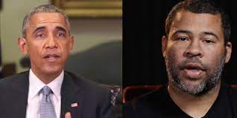
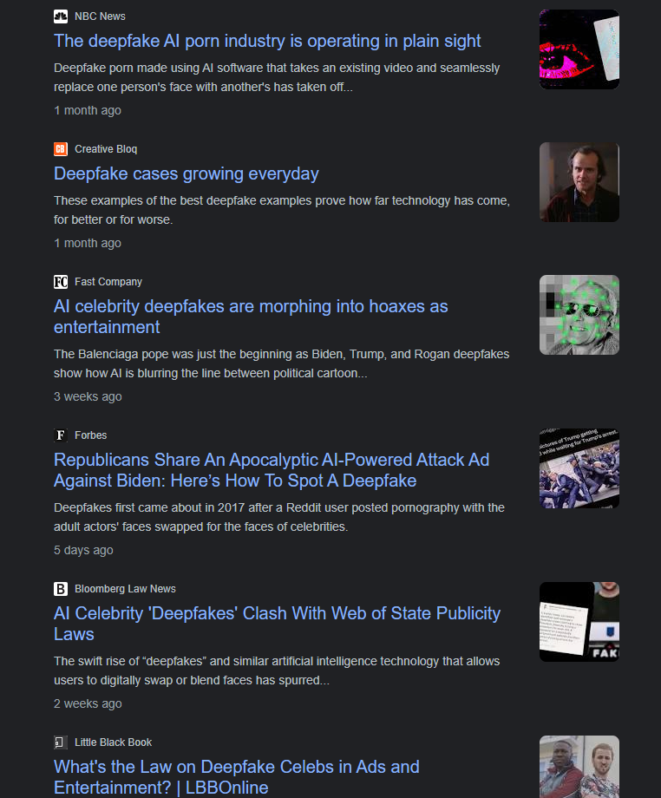
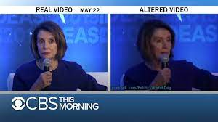


Slide 7
THE PURPOSE
Growing concern about deepfakes due to their potential harm to individuals and society.
Deepfakes are AI-generated media that manipulate visual or audio content to depict someone doing or saying something they never did in reality.
Detecting and combating deepfakes has become a critical challenge in the digital age.
The purpose of the project is to develop a deepfake detection system that accurately identifies fake videos created using machine learning techniques.

Slide 8
Dataset Exploration
Dataset from two different sources -
DeepFake detection challenge (Kaggle)
50% real and 50% fake video to avoid bias.
Removed audio altered DeepFakes from DFDC.
Dataset is then passed to pre-processing phase.

Slide 9
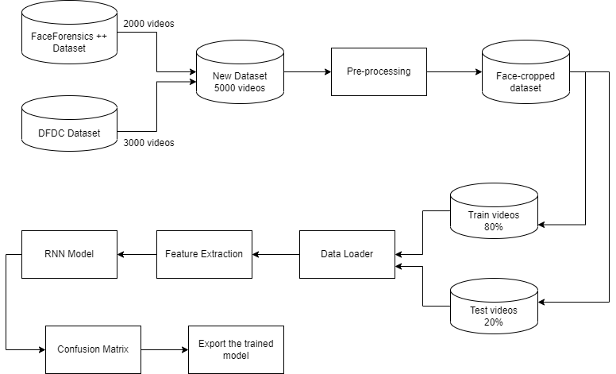
Training Workflow

Slide 10
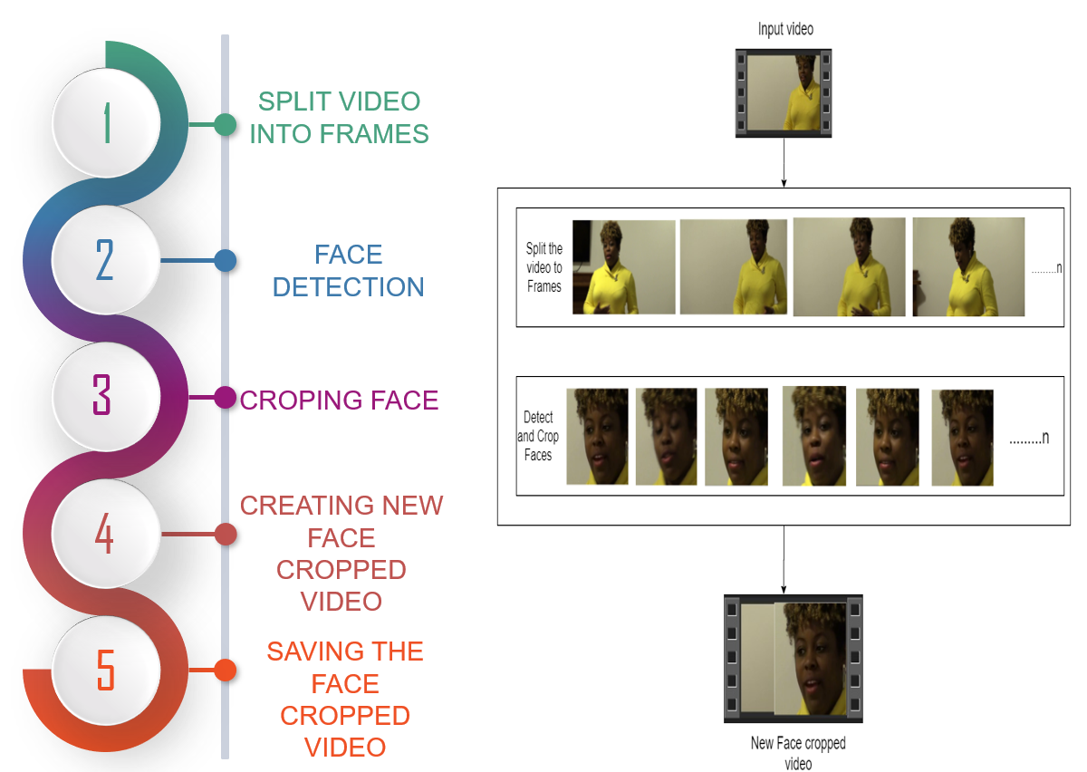
Pre-processing

Slide 11
Face Detection Algorithm
Created a balanced dataset of 50% real and 50% fake videos
Used OpenCV for face extraction
Determined 150 frames for each video for consistency
Applied Haar Cascade Classifier algorithm for face detection
Extracted and resized the face region to 112x112 pixels
Used VideoWriter function to create a new video file

Slide 12
Accuracies of other models
Title of Paper | Techniques Used | Dataset used | Accuracy
Deepfake Video Detection through Optical Flow based CNN[ | Convolutional Neural Network (CNN) | Face2Face | VGG16 81.61%, ResNet50 75.46%
FaceForensics++: Learning to Detect Manipulated Facial Images. | Xception net (CNN) | FaceForensics++ | 81%
Multi-scale face detection based on a convolutional neural network.[14] | Convolution Neural Networks (CNN) | 1. CelebA 2. AFW 3. FDDB | Discrete- 90% and for continuous, it is 74%
Exploiting Visual Artifacts to Expose Deep Fakes and Face Manipulations | The neural network classifier as MLP and the logistic regression model as LogReg | 1.CelebA 2.ProGAN 3.Glow | MLP 84%(Eyes), LogReg 83%(Eyes)

Slide 13
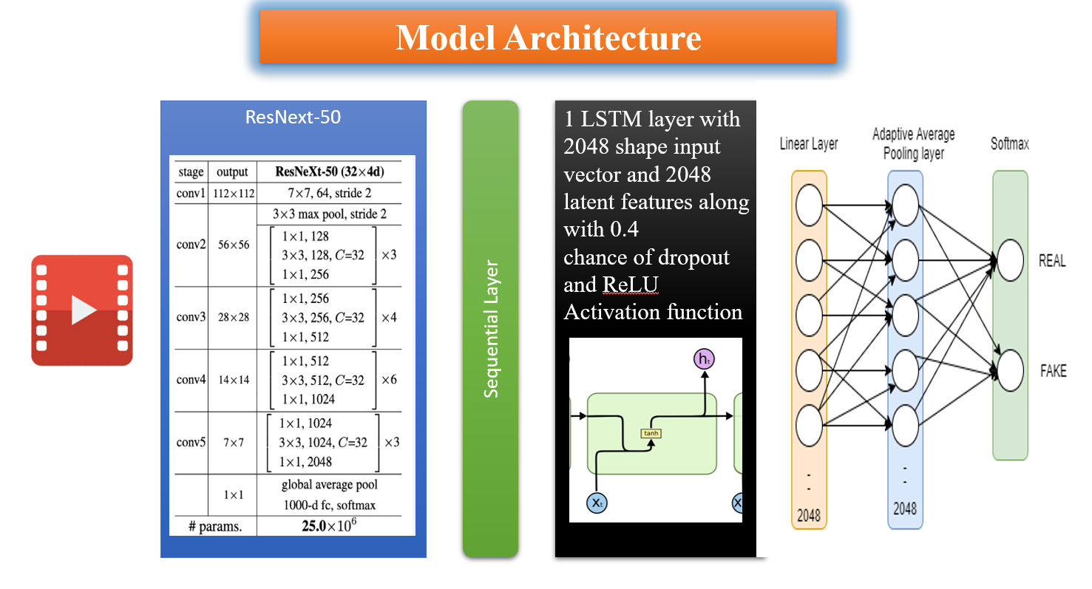

Slide 14
Questions Regarding ResNeXt Layer
Q1. What is resnext50_32x4d?
Q2. On what factors this model is predicting whether a video is fake or real?
Q3. So is res next detecting statistical differences too or is it just for feature extraction?
Q4. What are the statistical differences in the DF videos?
Q5. Why is LSTM not used directly without including res next?
Q6. How does resnext which is trained on imagenet dataset is able to detect statistical differences?
Q7.Why is resnext used as a CNN and why not other CNN like resnet or deepnet etc..

Slide 15
Questions Regarding LSTM Layer
Q1. Why is LSTM used as an RNN?
Q2. Why not other RNNs?
Q3. What are those temporal dependencies?
Q4. How a deepfake generated videos have temporal inconsistencies?
Q5. So is this model only capturing temporal dependencies or it is capturing other things too?
Q6. So given a video, explain in detail how this model will detect if it is deepfake or not?

Slide 16
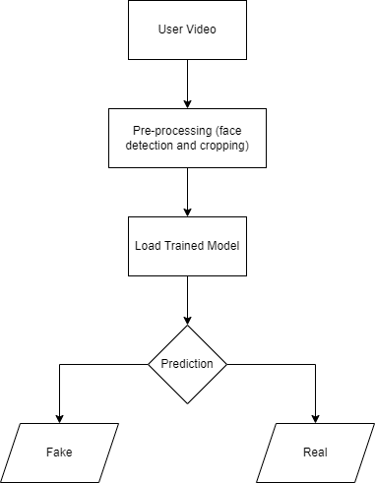
Prediction
Workflow

Slide 17
Results
Model Name | Sequence Length | Accuracry
model_10_frames | 10 | 83.22072072072072
model_20_frames | 20 | 86.03603603603604
model_40_frames | 40 | 89.1891891891892
model_60_frames | 60 | 91.8271085934174

Slide 18
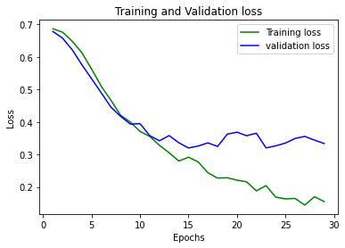
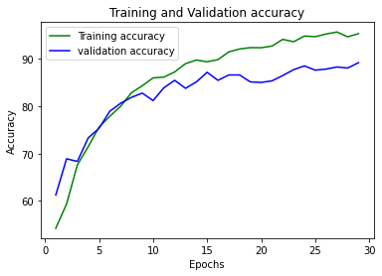
model_40_frames

Slide 19
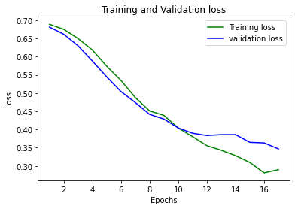
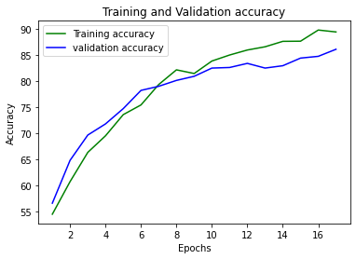
model_20_frames

Slide 20
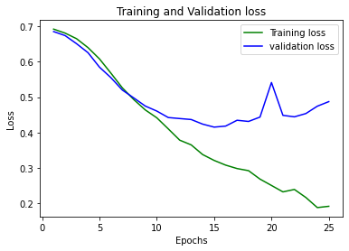
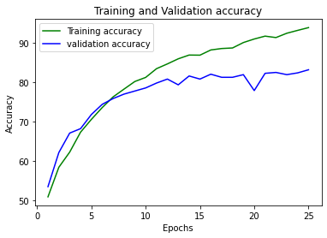
model_10_frames

Slide 21


Slide 22
Thank you!

